Slide 1
2020树德互助课堂
计算机程序设计基础-第三周
作者：易翔
模板分享：1522姚瑶
感谢图片分享者：15级摄影师董行

Slide 2
Recall
Power by James YU

Slide 3

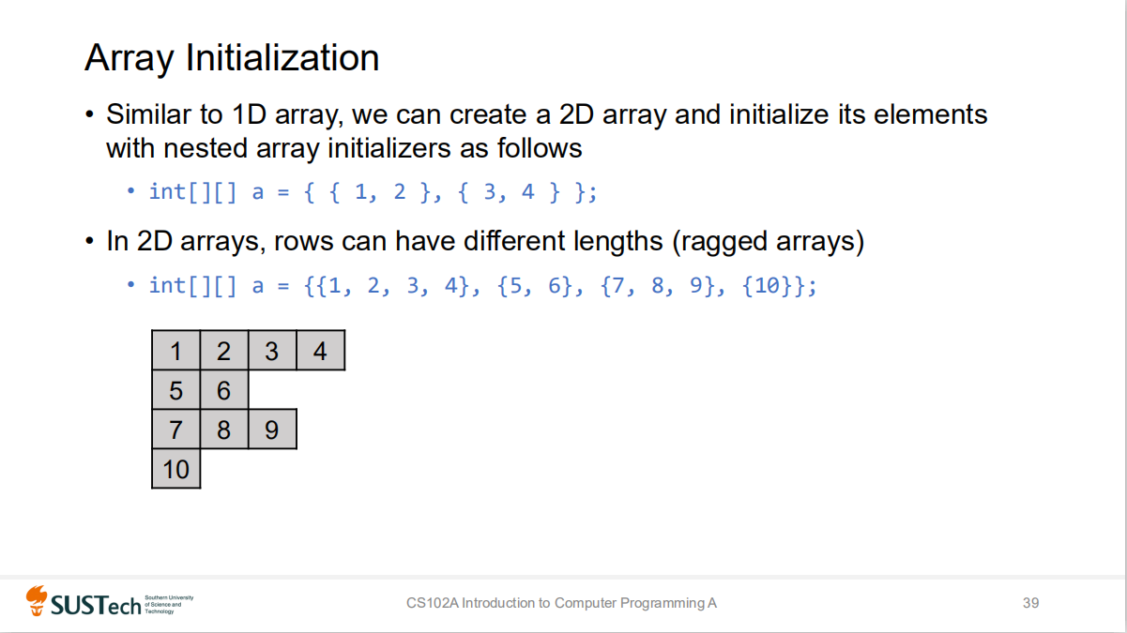

Slide 4
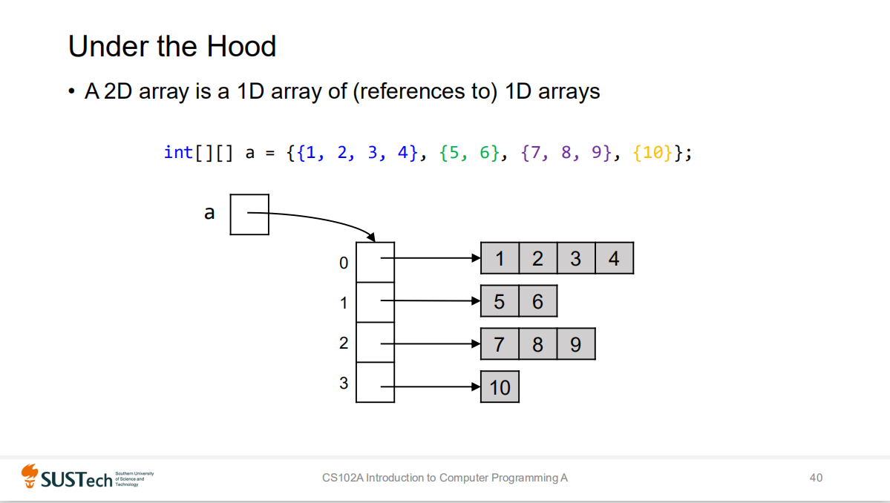

Slide 5
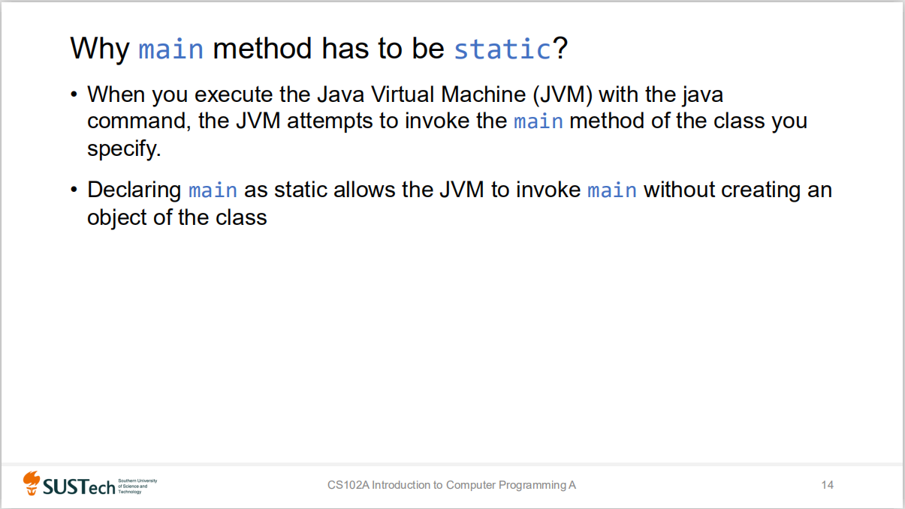

Slide 6
Pass-by-value in Java
In Java, all arguments are passed by value.
A method call can pass two types of values to the called method: copies of primitive values and copies of references to objects.
Although an object’s reference is passed by value, a method can still interact with the referenced object using the copy of the object’s reference (arrays are also objects).
The parameter in the called method and the argument in the calling method refer to the same object in memory.

Slide 7
CONTENT
1
Assignment 2 Hint
2
Classes and objects
3
Sample hand-writting code quiz

Slide 8
Part 1
Selected Hint for Assignment 2

Slide 9
SUSTech Ratio
A simple question, which require you to calculate the Greatest Common Divisor(gcd) of the input two integers.
gcd(a, b)
gcd(a, b)=gcd(b, a)
gcd(a, b)=gcd(a-b, a) (a > b or a = b)
gcd(a, b)=gcd(a%b, a)
The greatest common divisor has the same properties, but we don't need them.
public long gcd (long a, long b) {
return b == 0 ? a : gcd(b, a%b);
}

Slide 10
Git Merge
1 | 3 | 5 | 7 | 9
1 | 3 | 3 | 5 | 7 | 9
Print “Yes”

Slide 11
Git Merge
1 | 3 | 5 | 7 | 9
1 | 2 | 4 | 5 | 7 | 9
`
Print “No”

Slide 12
CS301
Another simple question, which require you to implement two array to store two binary string and add them together. The only thing you need to remember is that you should notice the order of carry-bit (进位) of the addition.

Slide 13
Dating Date
Run the meter
You can write down all the echo date (totally, 366). It is a very easy things you can do. Then you can initialize such an array in you answer like:
int[] array = {20200202, ......};
And the other thing you need to do is to check how many date are there is in the proving date time.
2. Positive solution
You have know that there is finite echo date. So why not implement it in your answer?
* From 01.01 to 12.31.

Slide 14
Which Restaurant
Hint: The only thing you need to do is to record and update the start_index and end_index of the continuous increasing array. After you traversal through the array, the two index you recorded is the answer index you need. Then use another for-loop statement to output the answer.
Bonus*
How to find the penult (倒数第二个) of the longest increasing continuous subsequence?
2. Bonus**
How to find the k^{th} of the longest increasing continuous subsequence?

Slide 15
Part 2
Here you can put something to give a brief introduction.

Slide 16
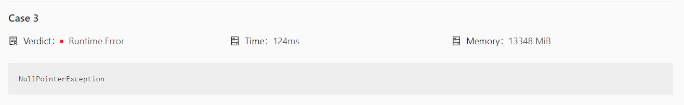
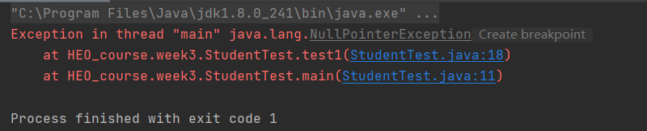
船新报错！
Null Pointer Exception!

Slide 17
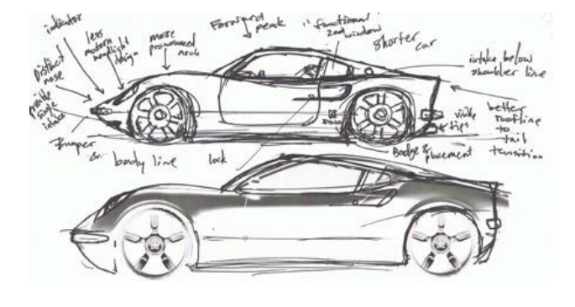
Why using more than one Class?
When solving some complex problem, we need to implement the corresponding functionality in several different classes and use one main class to activate them, rather than write all of them just in one class!
• class – a car’s engineering drawings (blueprint)
• method – designed to perform tasks (make a car move)
• object – the car we drive

Slide 18
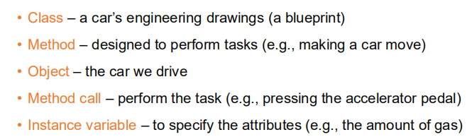
Why using more than one Class?
Similarly, an object has attributes that are carried with the object as it’s
used in a program.
These attributes are specified as the class’s instance variables. E.g., a bank account
object has a balance attribute (implemented as an instance variable) that represents
the amount of money in that account.

Slide 19
A sample class “Student”
keyword “class”
access modifier
name of the class
Brief summary of access modifier:
private- Visible only for this class;
public- Fully visible to the outside;
protected- Visible to this package and all subclasses;
(default)- Only visible to this package.

Slide 20
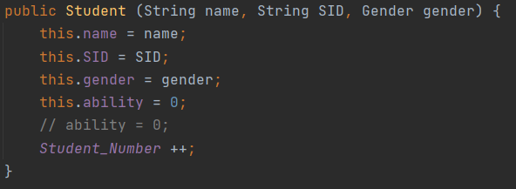

The Constructor

Slide 21
Some interesting features:
Overloaded constructor
Invoke another constructor with keyword “this”
Parameterless constructor

Slide 22
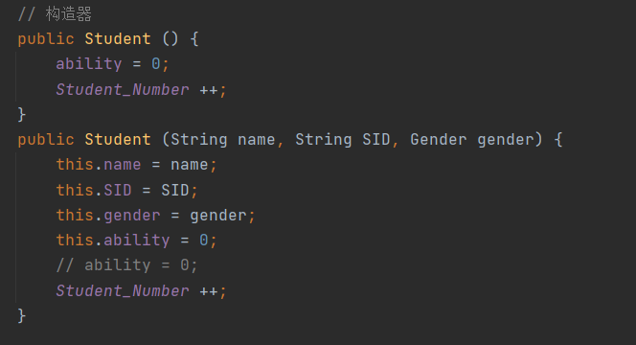
Overload(重载)
Overloading does not only occur in methods; it can also occur in the constructor of a class 。
Recall that when the argument list is different and the name of methods are same, the overloading occur. The same thing happen in the constructor.

Slide 23
Array Recall
• Similarly, in an array of a reference type, every element is a reference to
an object of the array’s declared element type.
GradeBook[] gradebooks = new GradeBook[ 12 ];
Besides, you can sorted the array as before. Through the static method in the util.Arrays. But you should implement the method compareTo() first!
Arrays.sort(students);

Slide 24
Elegant Programming!

Slide 25
Part 3
Sample hand-writting code quiz

Slide 26
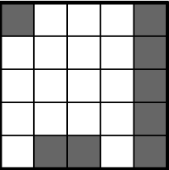
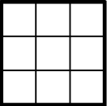

Hint
case 2
case 4
Consider how to enumerate all the cases that whether the four corners are printed or not?
There must be 16 (2⁴) cases, so you can consider the binary form of a number and use the displacement (>>>, >>, <<) to implement the things above. Then check if the cases satisfied the requirement.
case 1

Slide 27
Thank you for your listening！
模板分享：1522姚瑶
感谢图片分享者：15级摄影师董行

